Slide 1
Examining how schools and universities are constructed as heteronormative spaces
@DrAdamBrett

Slide 2
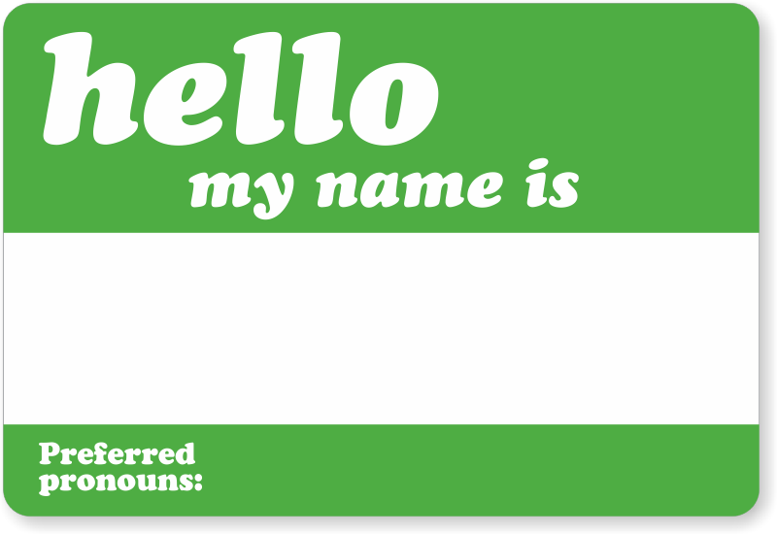
Introduction
Education researcher and Lecturer at University of Derby
Former Secondary teacher and senior leader for 15 years
Co-founder of Pride & Progress
Adam
He/Him

Slide 3
Key terms used in this talk
LGBT+/queer
Cisgender
Heteronormativity

Slide 4
Aims
Explore the ways schools and universities are constructed as heteronormative spaces
Examine the impact of heteronormativity
Share best practice

Slide 5
Question
When did you first see, hear, or learn about heterosexual lives when you were at school?

Slide 6
Heteronormativity
The assumption or expectation that people are cisgender and heterosexual.
How do we know this assumption exists?
Let’s start by unpicking gender assumptions…

Slide 7
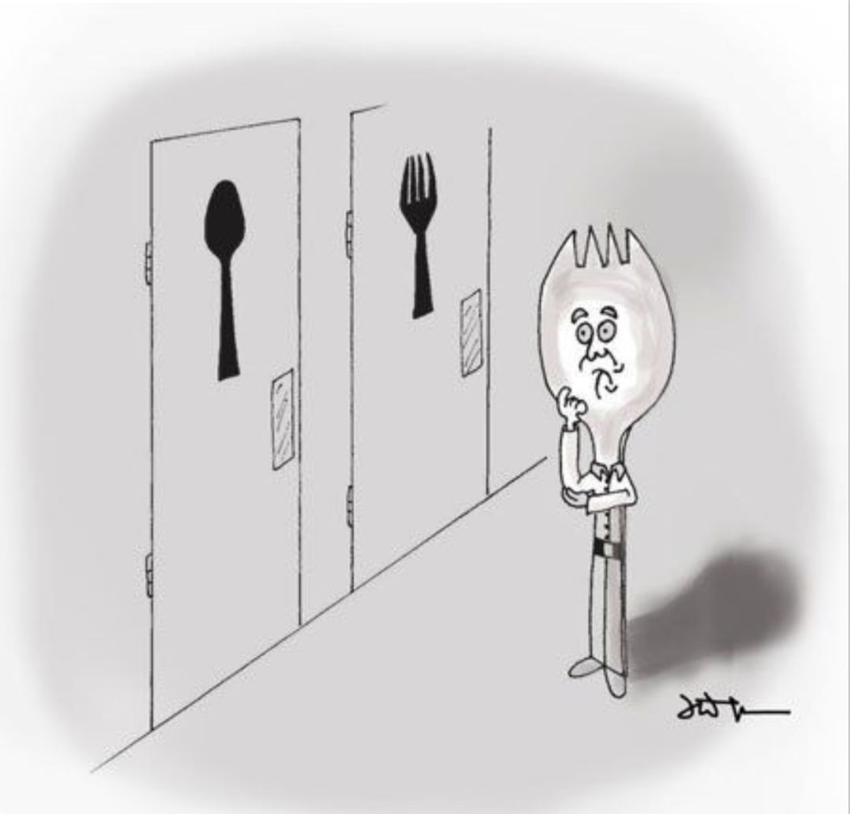
So, what is gender?

Slide 8
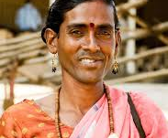
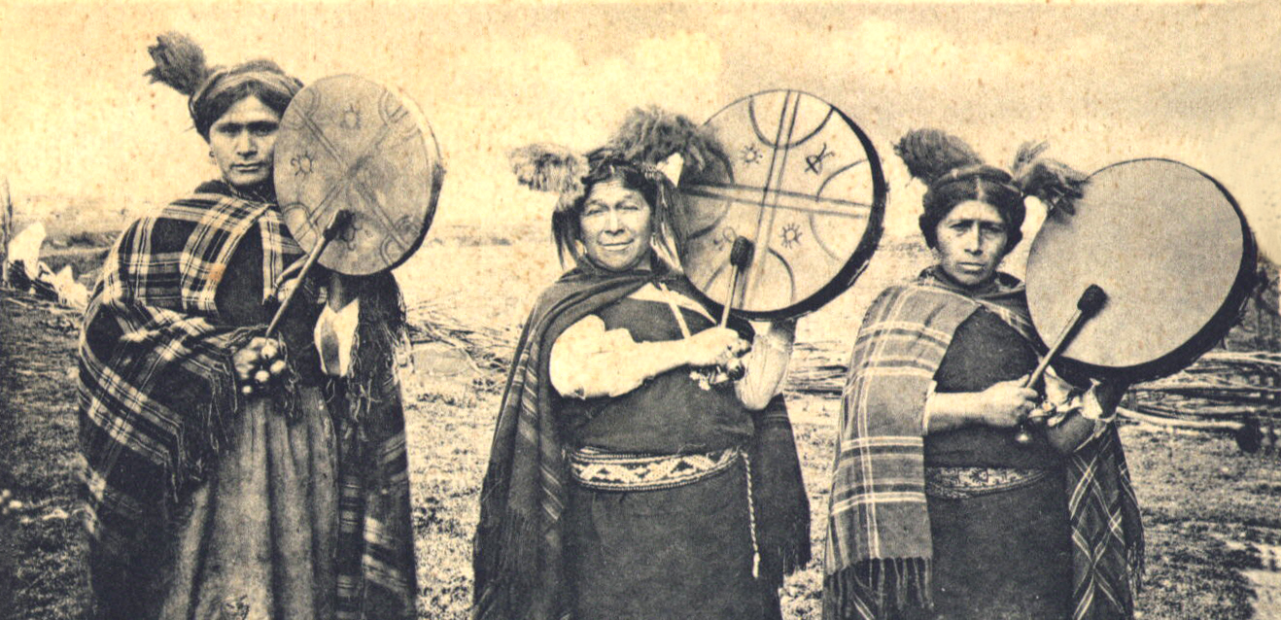
Gender across space and time
Hijra, India
Kathoey, Thailand
Machi, Chilie

Slide 9
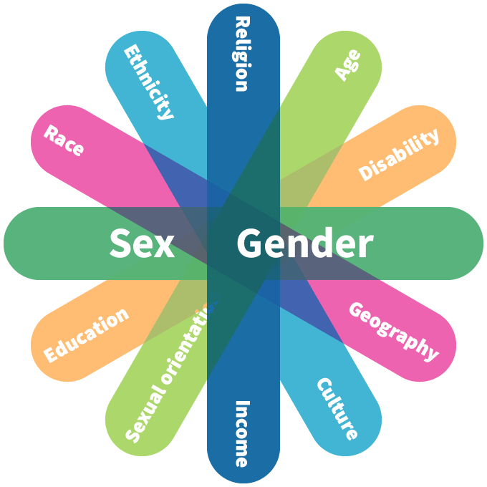
Intersectionality

Slide 10
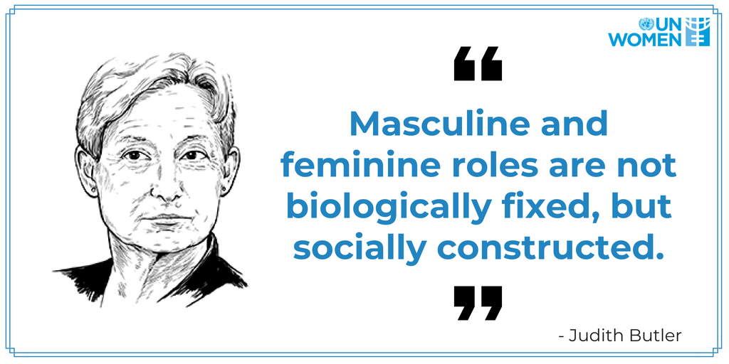

Slide 11
Is it a boy or a girl!?

Slide 12
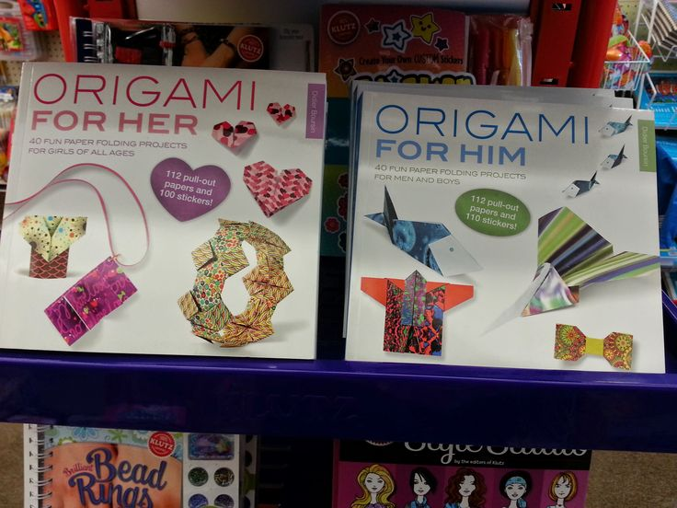
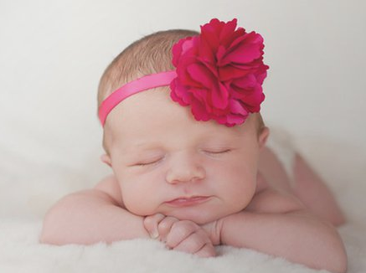
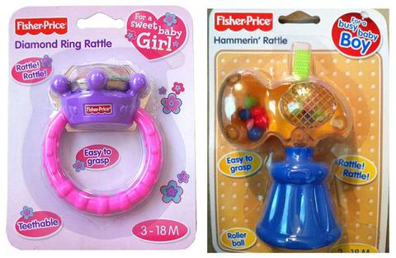
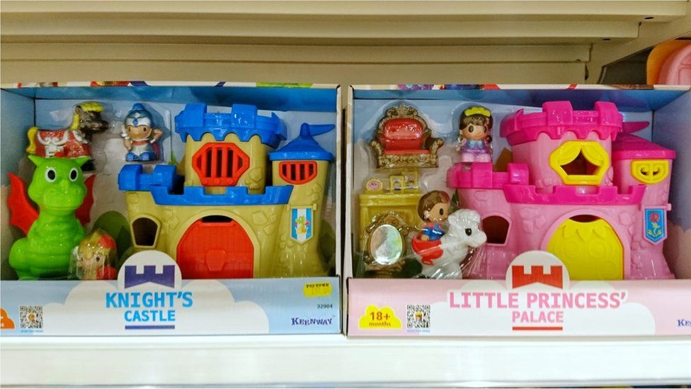

Slide 13
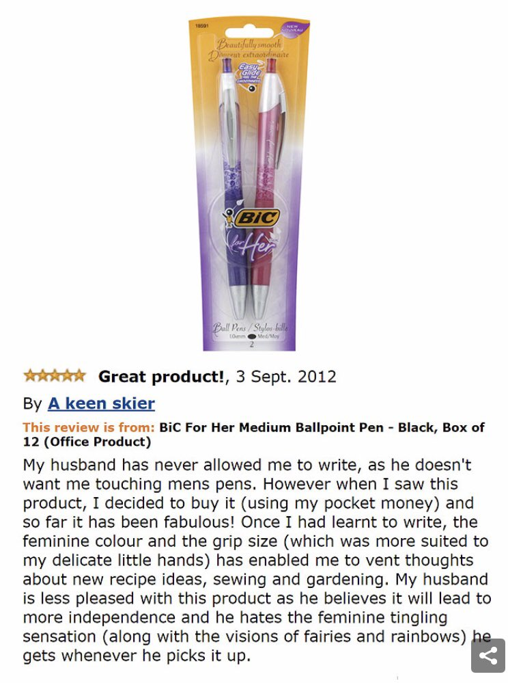

Slide 14
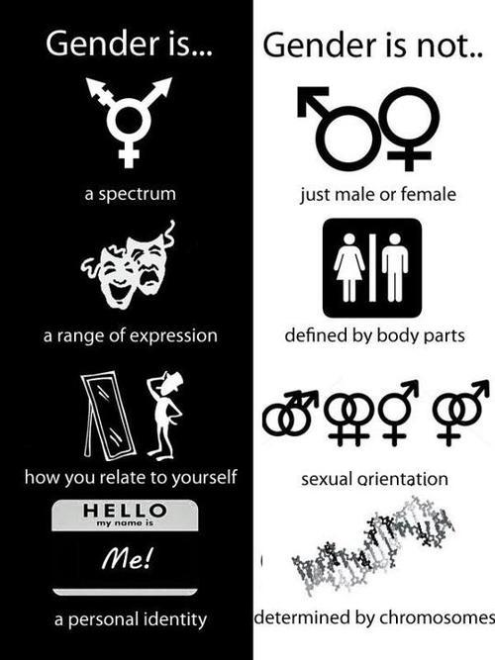

Slide 15
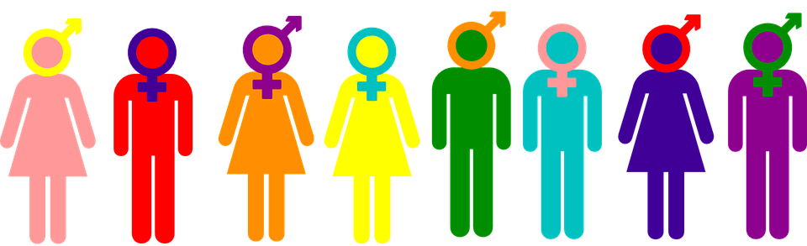
How are gender roles communicated in universities?
Which aspects of university life could prove challenging for a gender non-conforming student?

Slide 16
Constructing
heteronormativity…

Slide 17
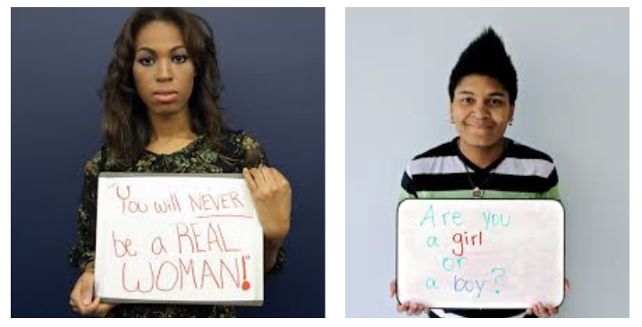
Microaggressions
Microaggression is a term used for commonplace daily verbal, behavioural or environmental slights, whether intentional or unintentional, that communicate hostile, derogatory, or negative attitudes toward stigmatized or culturally marginalized groups

Slide 18
Microassaults refer to explicit or purposeful comments or actions meant to demean or upset the recipient. This could include:
Homophobic language and abuse
Avoidance and isolating
Physical contact
!@%&!
Don’t let him join in!

Slide 19
Microinsults refer to unconscious, often well intended, verbal or non-verbal communication that can demean a person’s identity. For example:
The automatic assumption that boys like girls and vice versa “Do you have a girlfriend?”
Explicit male and female changing rooms or toilets may make a trans individual feel unsure/uncomfortable which to use and therefore implicitly feel they don’t belong in that environment
So, who wears the trousers?
Why hasn’t a pretty girl like you got a boyfriend?

Slide 20
Microinvalidations are comments/actions that dismiss the realities or experiences of being an LGBT+ individual. For example:
Assuming its easy to be an LGBT+ individual now due to improved legislation and attitudes
Telling a person who’s come out to you that it’s not a big deal; to them it may have caused serious anxiety and worry
Maybe it’s just a phase
But you don’t act gay!
You’re so brave to be a gay parent

Slide 21
Who does heteronormativity include and exclude?

Slide 22
https://www.stonewall.org.uk/system/files/rainbow_britain_report.pdf

Slide 23
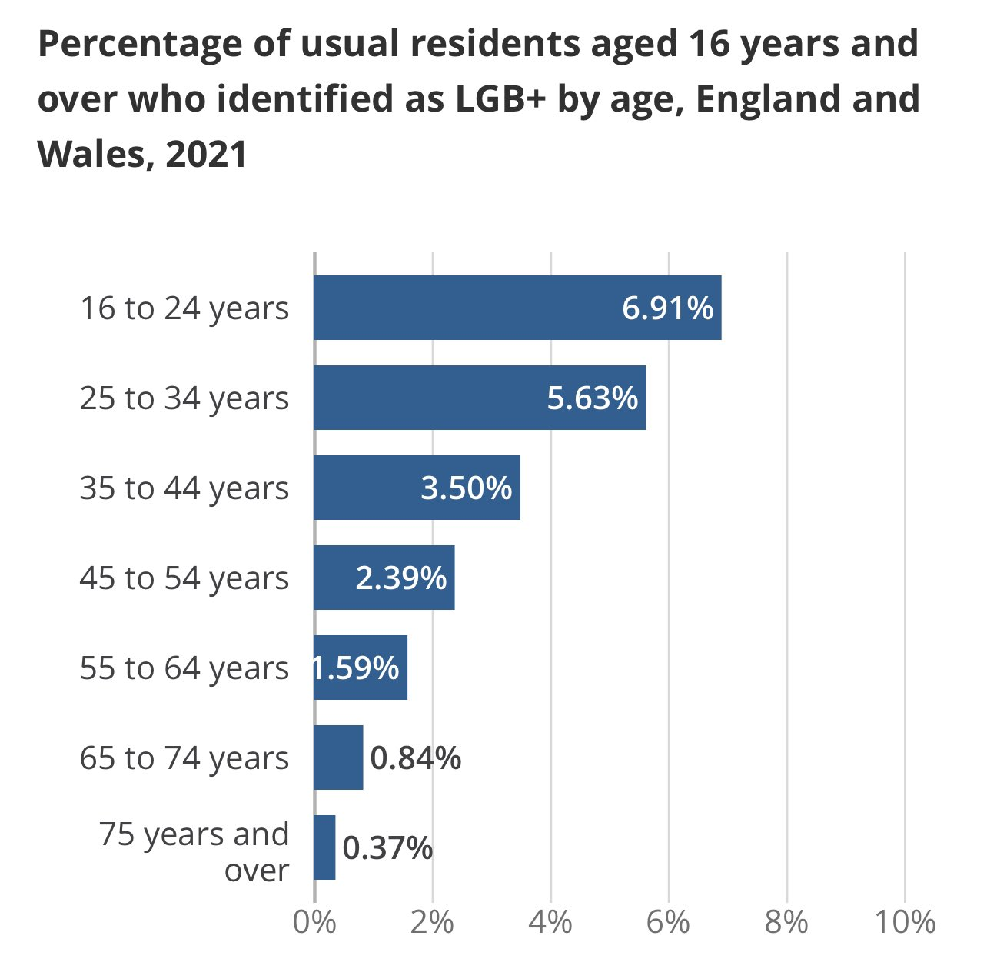
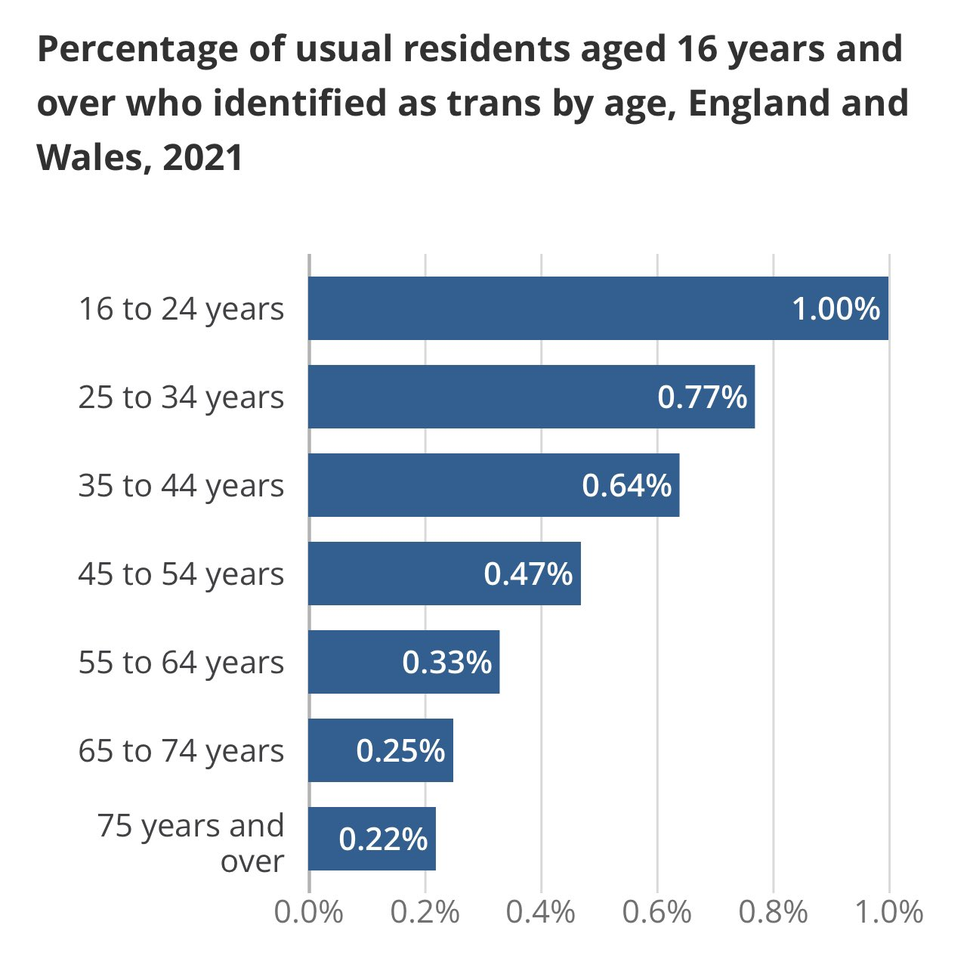

Slide 24
Homonormativity

Slide 25
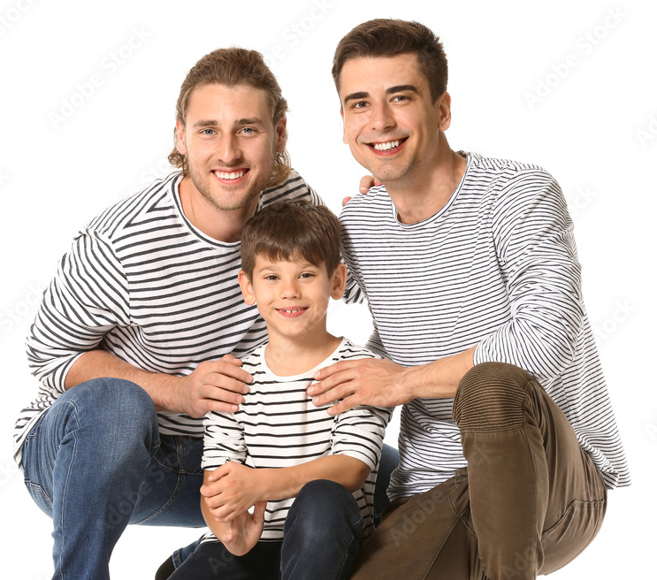
Homonormativity
Homonormativity suggests that LGBT+ people can assimilate into heterosexual society by enacting certain privileged ideals.
We could also argue that heterosexual people can be excluded in society by not conforming to these ideals

Slide 27
heteronormativity is less about sexuality, and more about privileging a set of normative practices, ideals, and characteristics.
When we do this, we make it okay to centre certain voices while marginalising others.
So how do we make schools and universities more inclusive for everybody?

Slide 28
Pillars of Inclusive Education
Common Inclusion Goal
Common Inclusive Language
Curriculum
Visibility & Representation

Slide 29
Pillars of Inclusive Education
Common Inclusion Goal

Slide 30
We want every person in our university community to feel free to be themselves, to feel seen, to feel safe, to feel supported, and to feel like they belong.
Common Inclusion Goal

Slide 31
Pillars of Inclusive Education
Common Inclusion Goal
Common Inclusive Language

Slide 32
What language is used in your classroom or university?
Which language shouldn’t be used?
Is sharing of pronouns usualised?
Do staff know how to tackle inappropriate language?
Common Inclusive Language

Slide 33
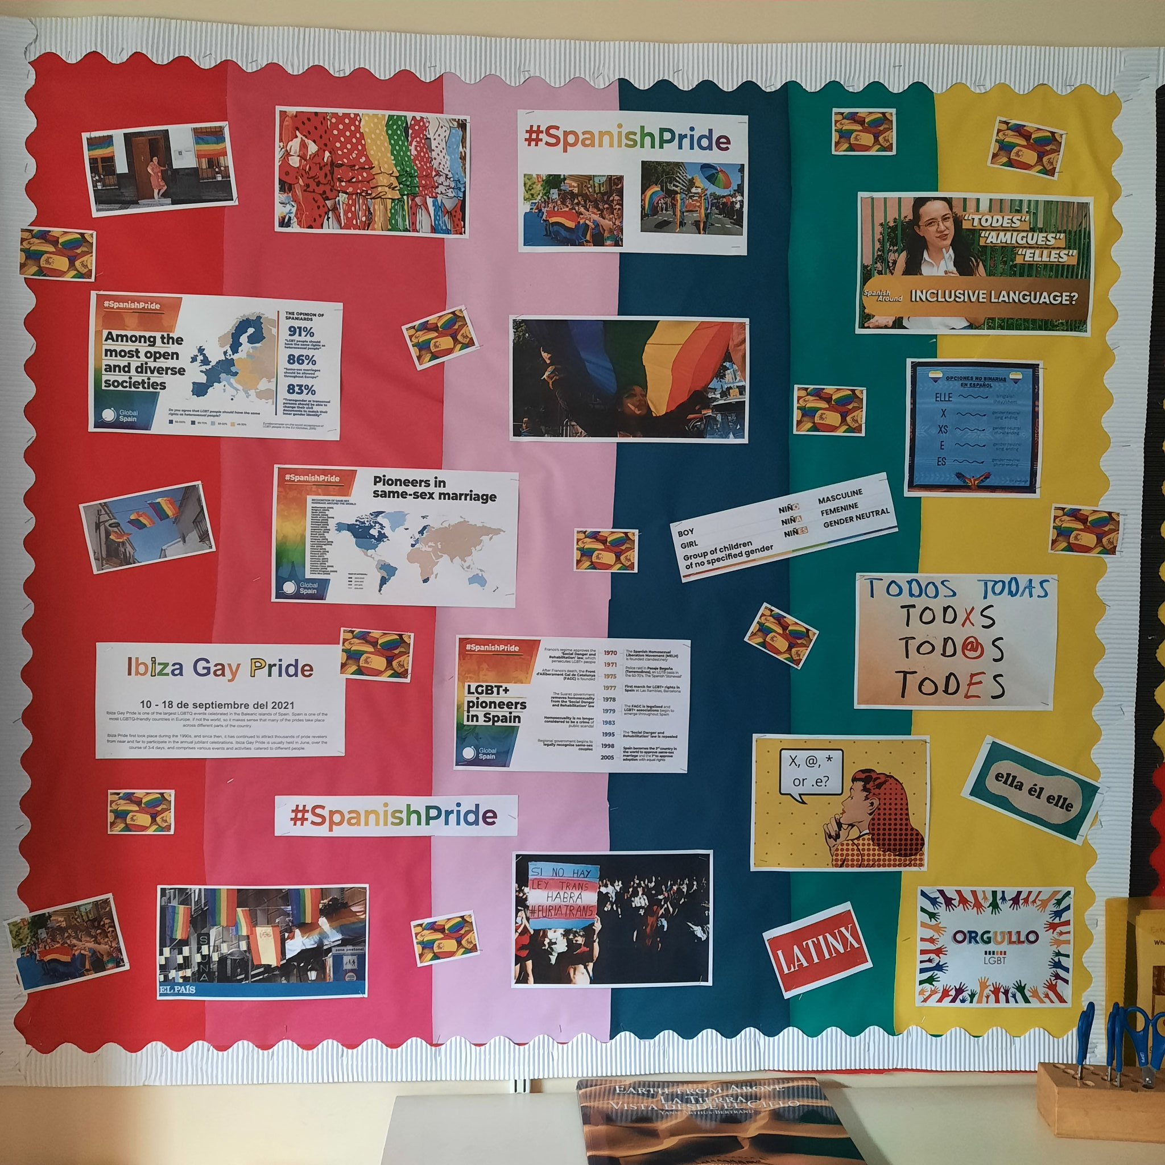
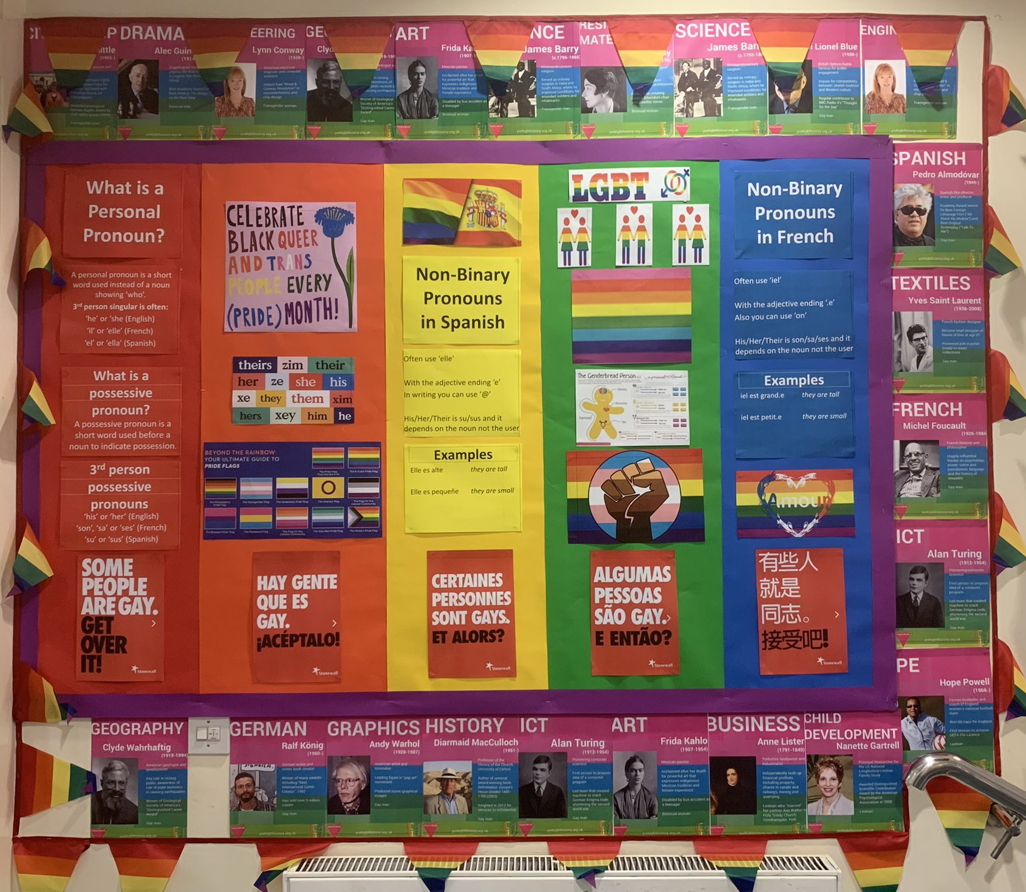
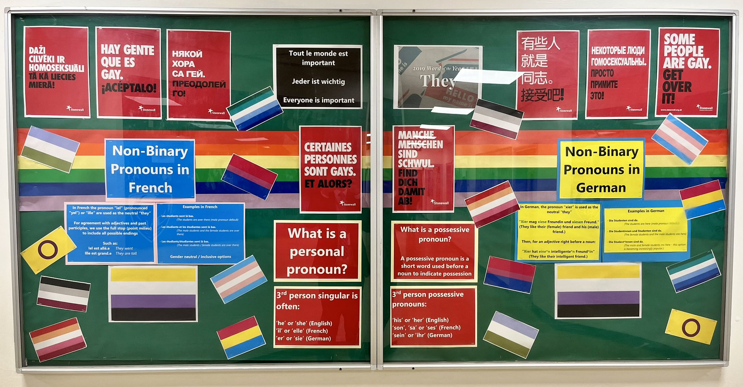

Slide 34
Pillars of Inclusive Education
Common Inclusion Goal
Common Inclusive Language
Curriculum

Slide 35
Texts
Significant figures
National days
Daily curriculum
Curriculum

Slide 36
Pillars of Inclusive Education
Common Inclusion Goal
Common Inclusive Language
Curriculum
Visibility & Representation

Slide 37
Available books
Signs & symbols
Displays
Expression
Visibility & Representation

Slide 38
What do these look like in your university?
Common Inclusion Goal
Common Inclusive Language
Curriculum
Visibility & Representation

Slide 39
Top Tips
…Don’t worry about getting it wrong! Terminology and perceptions are always changing; It’s the effort that counts
Try and use gender neutral language (Ladies and gents, guys, folks, class, team, everybody)
Share pronouns in emails signatures/bios
Share others’ stories to develop empathy
Challenge inappropriate language and microaggressions
Be positive. LGBT+ issues are often talked about in very serious tones
You don’t need to be the expert
Be curious, ask questions, listen

Slide 40
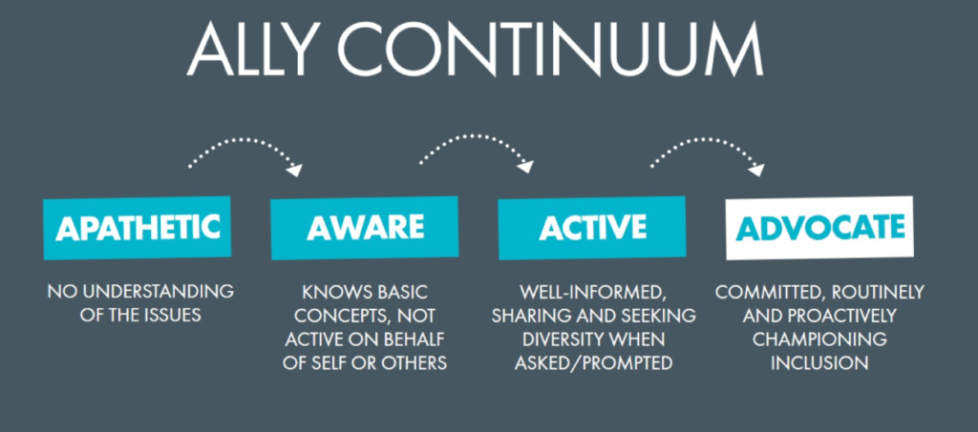

Slide 41
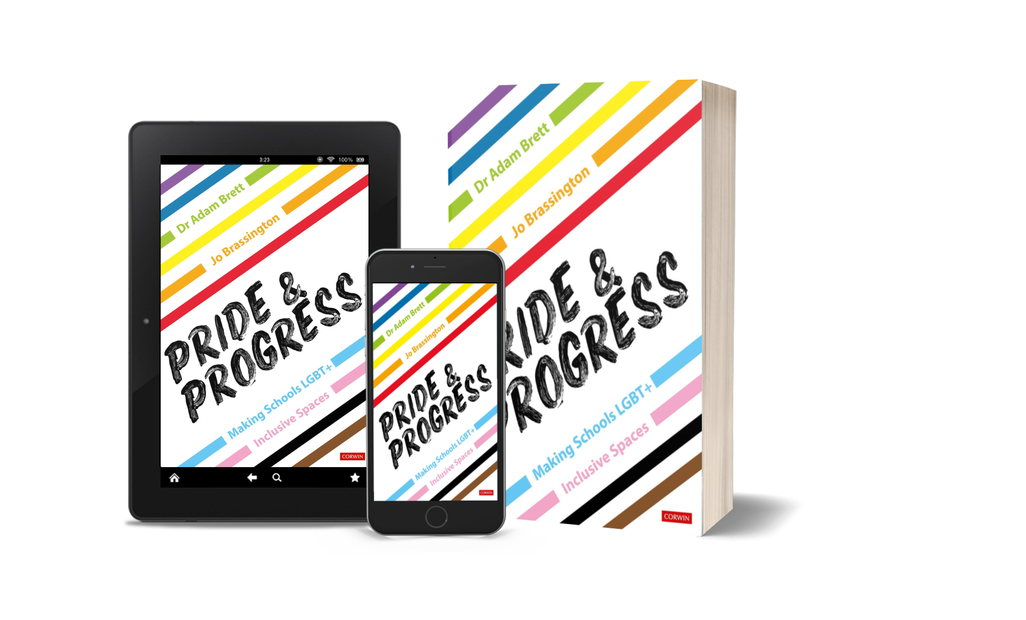
Pride & Progress
@PrideProgress

Slide 43
Thank you for listening – any questions?
a.brett@derby.ac.uk
@DrAdamBrett @Prideprogress

