Slide 1
2nd TPM 29-30 October, 2021, Leuven
JoinMe2

Slide 2
Friday, 29th
9:00-9:30 Welcoming and Introduction
9:30-10:15 Project Progress
10:15-10:30 Break
10:30-12:00 Budgetary Issues
12:00-13:30 Lunch Break
13:30-14:00 Maria’s Presentation on Pilot Survey
14:00-14:30 Survey Details
14:30-14:45 Break
14:45-16:30 Book Chapter
16:30-17:00 Q&A
SOCIAL EVENT: DINNER

Slide 3
What do we have ın common?
Group-1 | Group-2 | Group-3
Nesrin Ertürk | Maria Bedrossian | Mehmet Rojda Oruç
Kristof DeWitte | Franziska Bonna | Alisha Heinemann
Elenie Skourtoue | Tamsin Bowers-Brown | Electra Petracou
Marta Gierczyńska-Kolas | Gökçe Dönmez | Sarah Charles

Slide 4
PROJECT PROgrESS (after one year)
How did we start?
What did we do so far?

Slide 5
How dıd we start?
JoinMe2 Project aims at equipping Higher Education (HE) instructors with the necessary competence in equality and diversity so that they promote a learning environment that is conducive to learning. If a student feels uncomfortable, unsafe, or not respected, then their chances of success dramatically decrease. As a result, this situation hinders students' ability to fully participate in society as independent and responsible citizens.

Slide 6
With that ın mınd….
ethnic/racial diversity,
gender,
sexual orientation,
cultural diversity
disabilities.

Slide 7
And 4 outputs
Output 1: Inclusive Education: descriptive and comparative analysis The empirical surveys will help us identify existing attitudes and beliefs towards the concept. The country-specific study texts derived from the collected data will reveal the situation in all partner counties.

Slide 8
Output 2
Output 2: Inclusive Education Portal All the activities conducted in Output 2 serve the aim of designing/creating the educational material for the courses to be offered in the training portal. This requires project activities such as literature review and material development based on a common checklist/guideline shared by all partner institutions. It further aims at ensuring and increasing the reliability and validity of the educational material. As one of the aims of the project is to disseminate a free, but high quality inclusive education training, this stage is of crucial importance to the success and planned results of the project.

Slide 9
Output 3
Output 3: Training The activities carried out at this stage form the core of the whole project, which is implementing the inclusive education training by the use of an experimental set-up. Since pre-tests and post-tests will be given to training participants before and after the training, it will serve as a measurement of the effectiveness of the training.

Slide 10
Output 4
Output 4: Knowledge Portal The development of this portal will be the main means for reaching the expected results of the project as this will be the platform in which all the information, documents, reports, project results and further studies on inclusive education will be shared. Inclusive education and the issue of diversity are not topics that are limited to the countries involved in the project. Neither are they limited to HE. Therefore, the inclusive education training portal will be of most use to teaching and learning practitioners at all levels of education, to teacher candidates, teacher trainers, the programme leaders, heads of schools, directors of Teaching and Learning Centers and/or Centers of Excellence worldwide.

Slide 11
What dıd we do so far?
Kick off 17.11.2020

Slide 12
catch up 22.01.2021

Slide 13
2nd TPM 18 June 2021

Slide 14
Who we are?
IZMIR UNIVERSITY OF ECONOMICS - TURKEY
KATHOLIEKE UNIVERSITEIT LEUVEN - BELGIUM
PANEPISTIMIO AIGAIOU – GREECE
AKADEMIA POMORSKA W SLUPSKU - POLAND
UNIVERSITY OF DERBY – UK
UNIVERSITY OF BREMEN - GERMANY
LİMON AĞACI KÜLTÜR DERNEĞİ- TURKEY

Slide 15
BREAK

Slide 16
Budgetary Issues
Payments made so far:
40% of total budget of each instituition
-Timesheet-1
-Timesheet-2
-TPM2 travel costs

Slide 17
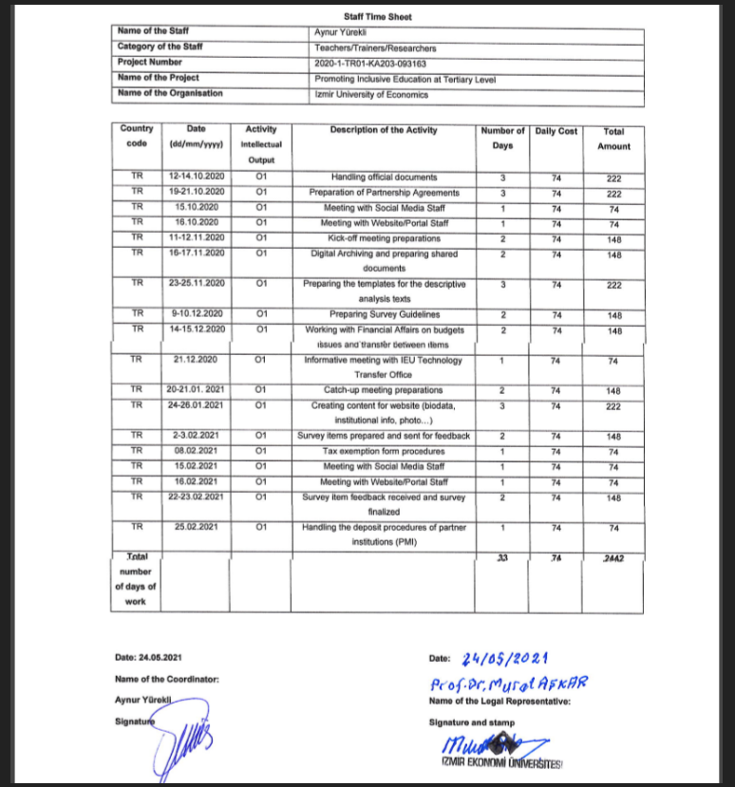
TIMESHEETS
Signed by one representative and the researcher
 | Timesheet-1 | Timesheet-2 | Daily cost (Euro)
Dates | 01.09.2020-28.02.2021 | 01.03.2021-30.09.2021
Spulsk | 12 | 8+15 =23 | 74
Leuven | 12 | 8+15 =23 | 214
Limonağacı | 20 | 10+15=25 | 74
Panepistimio | 12 | 8+15 =23 | 137
Bremen | 12 | 8+15 =23 | 214
Derby | 12 | 8+15 =23 | 214

Slide 18
LUNCH BREAK

Slide 19
MARIA’S PRESENTATION

Slide 20
Pilot Survey & Survey Details
PILOT
186 student participants
(Turkey 45; Greece 28; Belgium 43; UK 16; Germany 2; Poland 52)
126 instructor participants
(Turkey 34; Poland 27; UK 7; Greece 40; Belgium 18)
ACTUAL DATA COLLECTION
6 X 500 student surveys (500 from each country)
6 x 100 instructor surveys (100 from each country)

Slide 21
BREAK

Slide 23
TIME TO THINK TOGETHER
What were the most outstanding points you noticed during your literature review about your own country?
Depending on your research which areas seem to be the main center of attention during material development for training instructors?
Group1 Group 2
Kristoff Maria
Gökçe Rojda
Electra Elenie
Sarah Tamsin
Alisha Fransiz
Marta

Slide 24
QUESTIONS AND ANSWERS

Slide 25
Saturday, 30th
9:30-10:30 Documentations
10:30-10:45 Break
10:45-12:00 Looking Ahead

Slide 26
Documentations
A) Timesheets
B) Partnership Agreements
C) Formal Affiliation Links
D) Certificate of Participation

Slide 27
Book and Publishing Issues
OLIVER WAXMANN PUBLISHING

Slide 28
Looking Ahead
Material Development
Deadlines
Next Meeting

Slide 29
Material Development
How to organize the material development process?
All partner countries being responsible from all 5 aspects?
OR
Distributing the 5 aspects among partner countries?

Slide 30
deadlınes
SURVEY: Suggested date 15, Dec, 2021
COUNTRY SPECIFIC TEXTS: Suggested Date: 1. March, 2022

Slide 31
Next meetıng
ONLINE
POSTPONED TO
29-30TH OF Oct., 2021

Slide 32
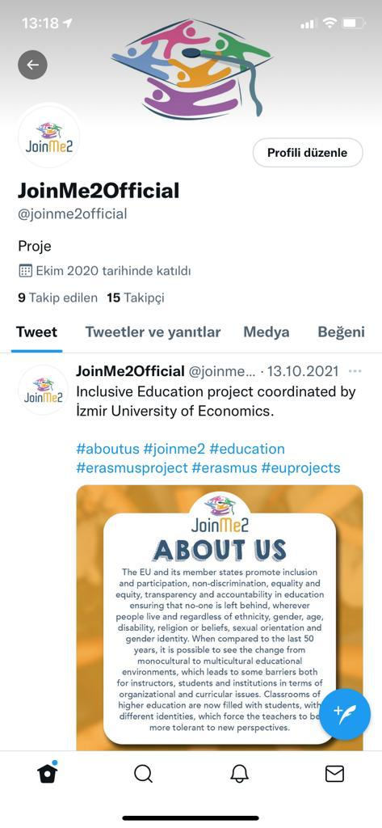
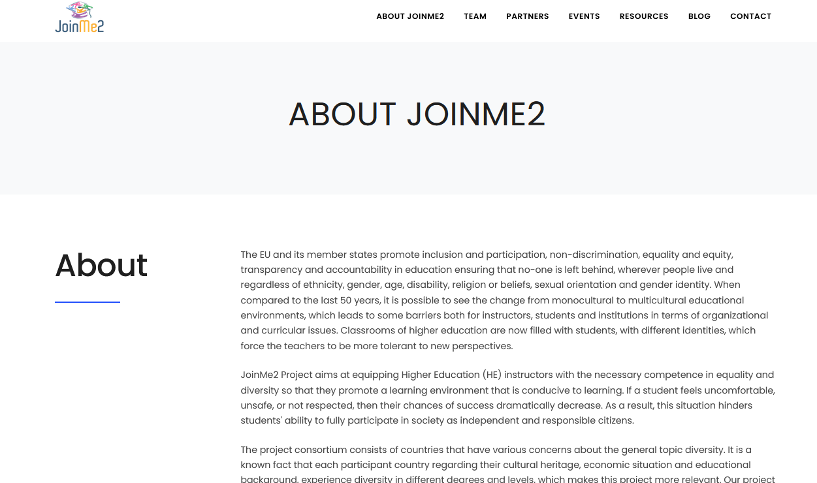
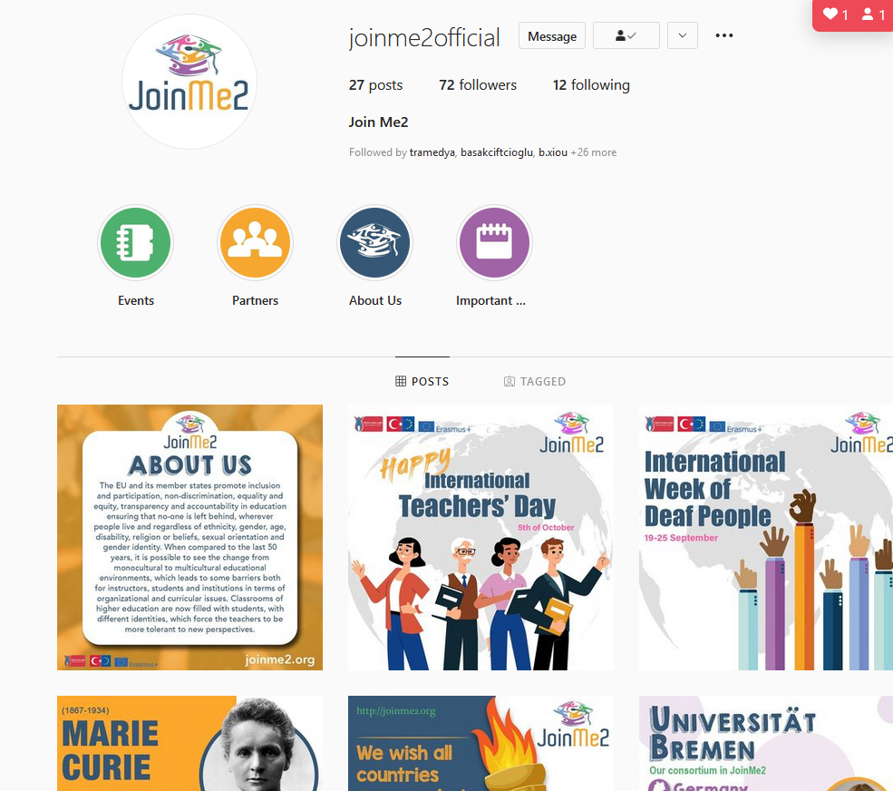
joınme2 on the ınternet
http://joinme2.org
Instagram
Twitter

Slide 33
Thıngs to do
Check the web site and please send the necessary information needed
Blog entries
Turkey: Done-April
Poland: November, 2021-May, 2022
Germany: December, 2021 –June, 2022
Greece: January 2022, -July, 2022
Belgium: February 2022, -August, 2022
UK: March, 2022 – September, 2022

Slide 34
Our sample blog entry

Slide 35
Thank you
ANY COMMENTS?

