Slide 1
JOINME2 TPM5
Bremen, Germany
16-17 March, 2023

Slide 2
Agenda 16 March, 2023 Thursday
9:30 -10:00 Welcoming and Introduction
10:00-11:30 Updates on the training modules
Labor distribution (training evaluation)
11:30-11:45 Coffee Break
11:45-13:15 Budgetary Issues
13:15-14:30 Lunch Break
14:30-17:00 Conference Preparations
19:30 Dinner

Slide 3
Updates on the training modules
Feedback
No major revisions needed on content

Slide 4
Plan for piloting
Finding the volunteers
10 per country
Passwords
Keep track of the code holders
Dates
Reporting the Results
Evaluation
March, 20-April, 30
Module
Training
1
2
3
4
5

Slide 5
The process
Every partner institution will receive 10 passwords
Passwords to be distributed to 10 different faculty members
Deadline April,30 2023
We will receive the pre-post test results
Evaluation of the data
Presenting at JOINME2 Conference

Slide 6
Labor distribution (training evaluation)
Each group working on modules will be responsible for the evaluation of their own module survey.
Onboarding (Ali, Marta, Nesrin) + Offboarding (Geri, Aynur): pre-post test
Disability: Gökçe – Rojda
Sexual Orientation: Oliver-Kristof
Sex, Gender, Identity: Franzi – Anna
Race, Ethinicity and Culture: Maria-Vana

Slide 7
Timeline
End of Project
March, 20
Starting the piloting
April, 30
End of Piloting
May,30
Evaluation
June, 14-16
Conference, TPM in İzmir
August, 30

Slide 8
COFFEE BREAK

Slide 9
Budgetary Issues 1 Travels (Including Bremen)
Getting ready for the final Report
Belgium: 8 travels - 4 used
Antalya: 8 travels - 6 used
Poland: 8 travels – 4 used
Greece: 8 travels - 3 used
Germany: 10 travels - 4 used
UK: 10 travels - 3 used

Slide 10
Budgetary Issues 2 Staff Cost
Getting ready for the final Report
Belgium: 85
Antalya: 55 Researcher+ 40 Technician
Poland: 85
Greece: 85
Germany: 85-5
UK: 85-5

Slide 11
LUNCH BREAK

Slide 12
CONFERENCE
How to promote?
Conference website
Program
Keynotes
Conference Dinner

Slide 13
How to Promote
Contacting universities
Social Media
Personal Contacts

Slide 14
Cıonference Web Page
https://joinme2.org/

Slide 18
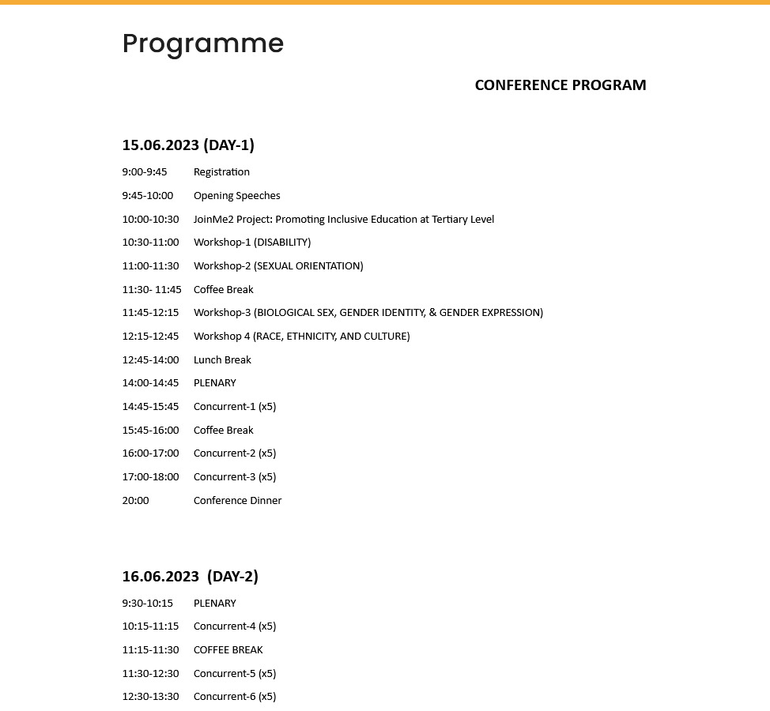
CONFERENCE PROGRAM

Slide 19
KEYNOTE 1 15 June, 2023 Associate Professor BURAK KARABEY BUCA FACULTY OF EDUCATION DEPARTMENT OF SPECIAL EDUCATION Dr. Burak Karabey is a researcher at Dokuz Eylül University , Faculty of Education. He did his PhD degree on Creative and Critical Thinking Style of Gifted Children in Primary and Secondary School. He is also interested in “Problem Based Learning, Problem Solving, Critical Thinking, Mathematics Education and Teacher Education” He has been involved various international and national projects related to Creativity, Innovation, Social Inclusion and teacher training.

Slide 20
KEYNOTE 2 ???

Slide 21
Food for Thought
Conference Dinner?

Slide 22
Thank you

